Slide 1
Computer & It’s Components

Slide 2
Contents
Introduction to the Computer
Hardware & Software
Components of Computer System
Conclusion

Slide 3
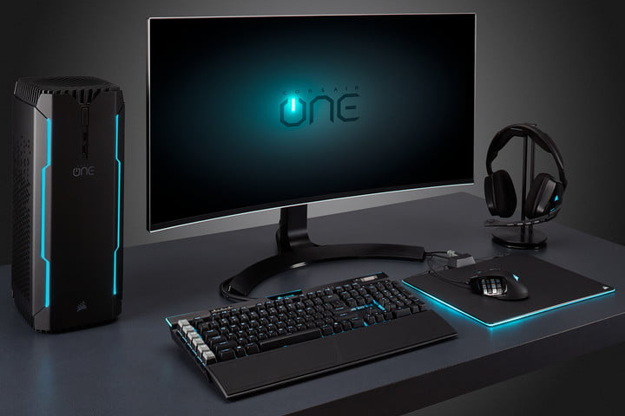
Computer
A Computer is a machine that can be programmed to accept data, process data into useful information and store it for later use.
A computer consists of Hardware and Software.
The machine is known as Hardware.
The programs are called Software.

Slide 4
Hardware & Software
Hardware
Physical parts of the computer, including processor and memory chips, input/output devices, tapes, disks, modems, cable, etc.
Software
Programs that tell the computer what to do. It provides instructions that the CPU will need to carry out.

Slide 5
Components of a Computer System
Input Devices
Processing Device
Output Devices
Storage Devices

Slide 6
Input Devices
The data that is given to the computer is called Input. Input devices are used to input data and instructions into the computer. These devices send this data to the Processing Unit.

Slide 7
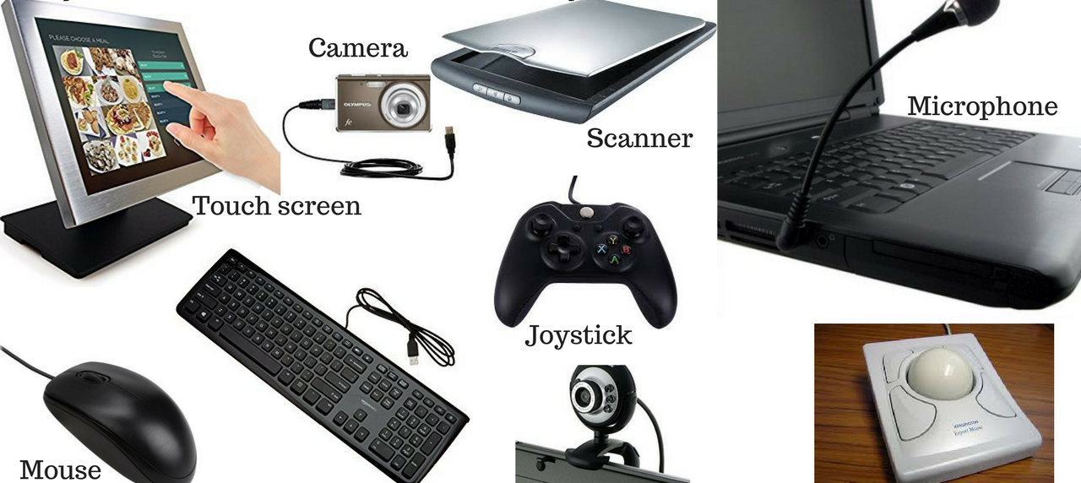
Following are some examples of Input devices :-

Slide 8
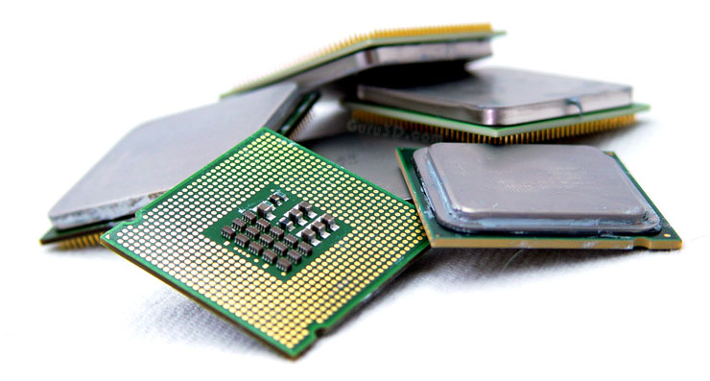
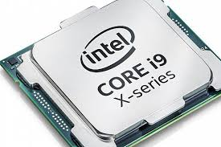
Processing Device
The Processor is used to process data. It is also called Central Processing Unit (CPU). It is the brain of the computer. It consists of electronics circuit. CPU interprets and executes program instructions. All computers must have a Central Processing Unit.
Following are some Examples of CPU :-

Slide 9
Output Devices
The data processed into useful information is called output. Output devices are used to display the result of processing.

Slide 10
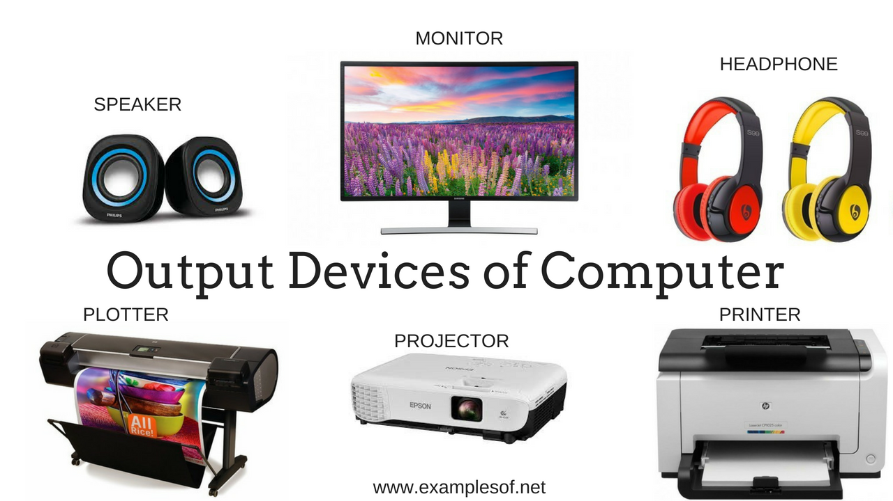
Following are some examples of output devices :-

Slide 11
Storage Devices
Storage usually refers to the Secondary storage. The main memory stores data and programs temporary & is called Primary Storage. The Secondary storage is required to store Data , Information and Programs permanently.

Slide 12
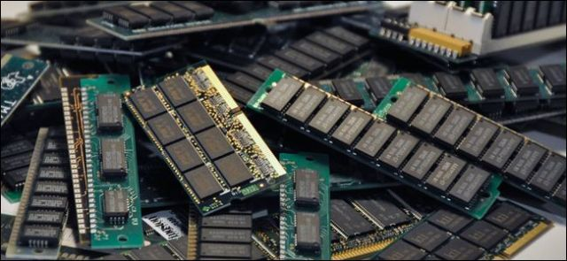
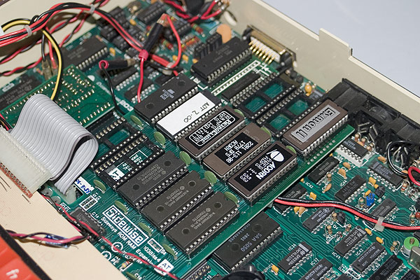
Following are some examples of storage devices :-
Primary Storage Devices
RAM
(Random Access Memory)
ROM
(Read Only Memory)

Slide 13
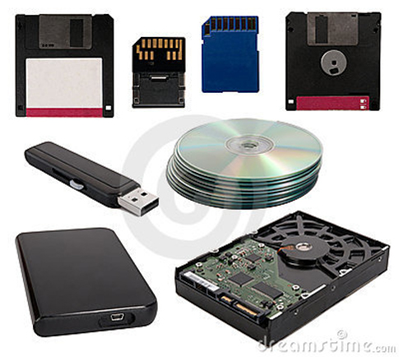
Secondary Storage Devices

Slide 14
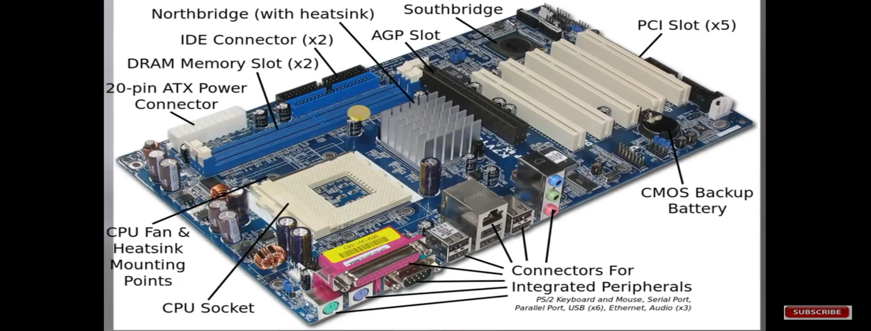
Motherboard

Slide 15
A Motherboard is one of the most essential parts of a computer system. It holds together many of the crucial components of a computer, including the central processing unit (CPU), memory and connectors for input and output devices.
It is a large board with integrated circuits that connect the various parts of computer e.g CPU, RAM, Disk Drives (CD, DVD, Hard disk) etc.
The Main Components which are directly attached to the Motherboard include :-
CPU
RAM
ROM
Connectors for Peripherals
Internal bus
Note
It is to be noted that all Components of Computer System are Linked with each other on a Motherboard . The Motherboard acts as a base for the communication or Interaction of Computer’s different Components.

Slide 16
Conclusion
A computer system requires different components to perform the functions of Input, Processing, Output and Storage and these four components are necessary for a computer to work.

Slide 17
Thank You

